Slide 1
Finding the Subnet, Broadcast and Useable Host Ranges
Lecture 16
Topic: Channelization

Slide 2
Introduction
Channelization is a multiple-access method in which the available bandwidth of a link is shared in time, frequency, or through code, between different stations.
Frequency-Division Multiple Access (FDMA)
Time-Division Multiple Access (TDMA)
Code-Division Multiple Access (CDMA)

Slide 3
FDMA
In FDMA, each user is allocated a unique frequency band or channel. During the period of the call, no other user can share the same frequency band.
Total system bandwidth is divided into narrow frequency slots. Each user is allocated a unique band or channel.
A user is free to transmit or receive all the time on its allocated radio channel, but the cost of transceiver is high, as each has to be designed on a different band.

Slide 4

Cont.

Slide 5
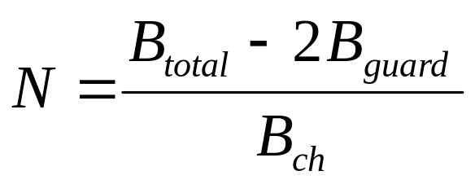
Number of channels in FDMA
Let B_{total} be the total system bandwidth, B_{guard} be the guard band at edge, B_{ch} the single radio channel bandwidth. Then the number of channels in a FDMA system:

Slide 6
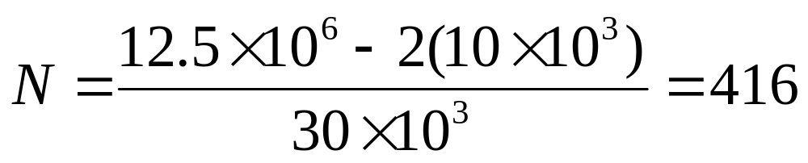
Example
AMPS uses FDMA with B_{total}= 12.5 MHz, B_{guard} =10 kHz and B_{ch} = 30 kHz. The number of channels in a FDMA system is

Slide 7
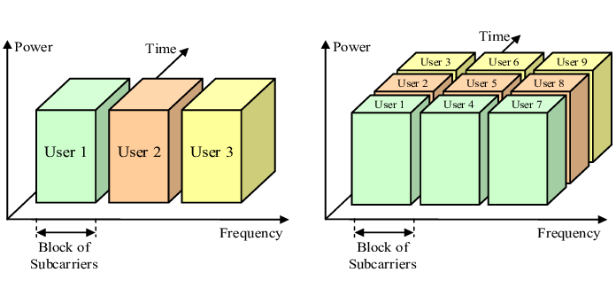
TDMA
Each user is allowed to transmit only within specified time intervals (Time Slots). Different users transmit in different Time Slots.
When users transmit, they occupy the whole frequency bandwidth (separation among users is performed in the time domain).
Figure: FDMA and TDMAre: TDMA

Slide 8
Cont.
TDMA systems divide the channel time into frames. Each frame is further partitioned into time slots. In each slot only one user is allowed to either transmit or receive.
Unlike FDMA, only digital data and digital modulation must be used.
Each user occupies a cyclically repeating time slot, so a channel may be thought of as a particular time slot of every frame, where N time slots comprise a frame.

Slide 9
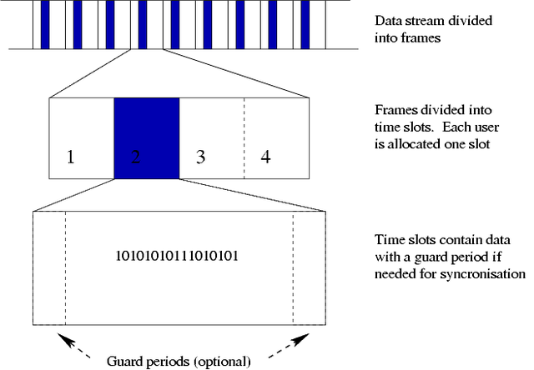
TDMA-frame structure

Slide 10
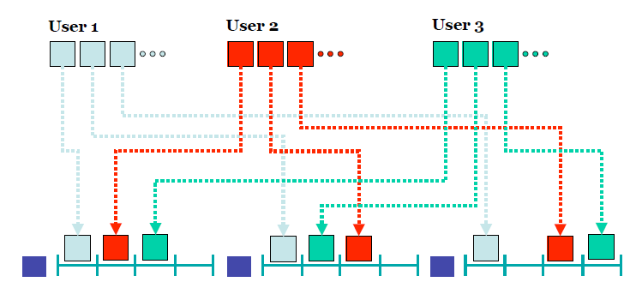
TDMA: Frame Structure

Slide 11
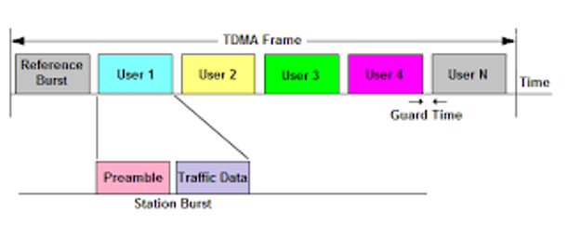
Cont.
In TDMA, each user is assigned a nonoverlapping time slot with a guard time, which avoids interference in neighboring channels. TDMA transmissions are organized in a frame structure, which contains one or two reference bursts that synchronize the network and identify the frame. Synchronization is one of major technical problems for implementing TDMA.

Slide 12
FDMA vs. TDMA
Frequency division is very simple: all transmitters sharing the medium have output power spectra in non-overlapping bands.
  Many of the problems experienced in TDMA due to different propagation delays are eliminated in FDMA
The major disadvantages of FDMA is the relatively expensive and complicated bandpass filters required.
  TDMA is realized primarily with much cheaper logic functions.

Slide 13
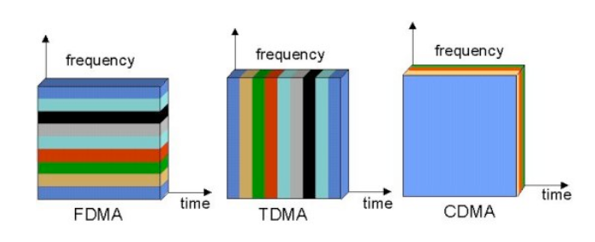
Cont.

Slide 14
CDMA
In CDMA each user is assigned a unique code sequence (spreading code), which it uses to encode its data signal.
The receiver, knowing the code sequence of the user, decodes the received signal and recovers the original data.
The bandwidth of the coded data signal is chosen to be much larger than the bandwidth of the original data signal, that is, the encoding process enlarges (spreads) the spectrum of the data signal.
  CDMA is based on spread-spectrum modulation.

Slide 15

Simple Idea with communication with code

Slide 16
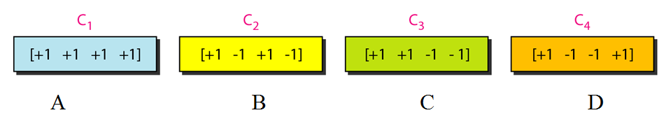
CDMA-Cont.
CDMA is based on coding theory.
Each station is assigned a code, which is a sequence of numbers called chips.
Suppose we have four stations; each has a sequence of chips which we designate as A, B, C and D.

Slide 17
Rules for encoding
If a station needs to send a 0 bit , it sends a -1.
If it needs to send a 1 bit, it sends a +1.
When a station is idle, it sends to signal, which is represented by a 0.

Slide 18

Example
The example shows how four stations share the link during 1-bit interval. The procedure can easily be repeated for additional intervals.
We assume that stations 1 and 2 are sending a 0 bit and channel 4 is sending a 1 bit. Station 3 is silent.

Slide 19
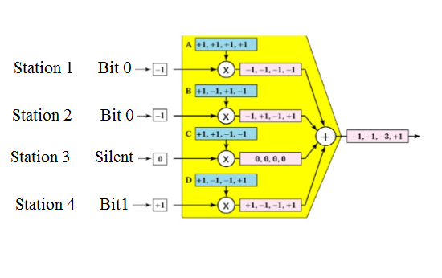
CDMA Multiplexer

Slide 20
CDMA Multiplexer-Cont.
The multiplexer receives one encoded number from each station (-1, -1, 0 and +1).
The encoded number sent by station 1 is multiplied by each chip in sequence A. A new sequence is the result (-1,-1,-1,-1). Likewise, the encoded number sent by station 2 is multiplied by each chip sequence in B. The same is true for the remaining two encoded numbers. The result is four new sequence.
All first chips are added, as are all second, third and fourth chips. The result is one new sequence.
The sequence in transmitted through the link.

Slide 21

Digital signal created by four stations in CDMA

Slide 22
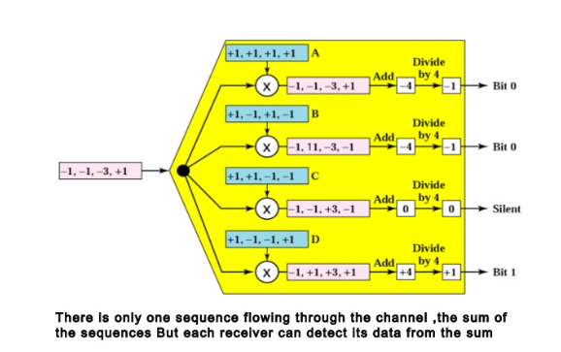
CDMA Demultiplexer

Slide 23
CDMA Demultiplexing steps
The demultiplexer receives the sequence sent across the link
It multiplies the sequence by the code for each receiver.
The chip in each sequence are added.
The result is always +4, -4 OR 0.
The result of step 3 id divided by 4 to get -1, +1 or 0.
The number in step 4 is decoded to 0, 1 or silence by the receiver.

Slide 24

Decoding of the composite signal for one in CDMA

Slide 25
Orthogonal Sequence generation
We did not choose the sequence randomly; the were carefully selected.
The sequence is called orthogonal sequence.
To generate sequence, a Walsh table, a two-dimensional table with an equal number of rows and columns are generated.
Each row is a sequence of chips.
The Walsh table W₁ for a one-chip sequence has one row and one column.
We can choose -1 or +1 for the chip for this trivial table (we choose +1).

Slide 26

Cont.
According to Walsh, if we know the table for N sequence, we can create the table for 2N sequences W_{2N}.
W_{N} with the overhead bar stands for the complement of W_{N}, where each +1 is changed to -1 and vice versa.

Slide 27
Properties of Orthogonal Sequences
Orthogonal sequences have properties that are suitable for CDMA. They are as follows:
If we multiply a sequence by -1, every element in the sequence is complemented (+1 becomes -1 and -1 becomes +1). We can see that when a station is sending -1 (bit 0), it is sending its complement.
If we multiply two sequences, element by element, and add the results, we get a number called the inner product. If two sequences are the same, we get N, where N is the number of sequences; if they are different, we get 0. The inner product uses a dot as the operator. So A.A is N, but A.B is 0.
The inner product of a sequence by its complement is -N. So A.(-A) IS -N.

Slide 28
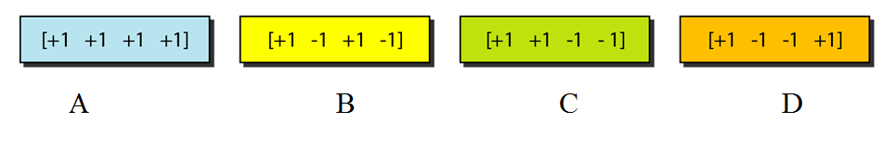
Example
Check to see if the second property about orthogonal
codes holds for the given CDMA example.
Solution:
The inner product of each code by itself is N. This is shown for code C. It can be proved that it holds true for the other codes.
C.C=[+1,+1,-1,-1].[+1,+1,-1,-1]=1+1+1+1=4
If the sequences are different, the inner product is 0.
B.C=[+1,-1,+1,-1].[+1,+1,-1,-1]=1-1-1+1=0

Slide 29
Example
Check to see if the third property about orthogonal codes
holds for CDMA example.
Solution:
The inner product of each code by its complement is –N. This is shown for code C.
C.(-C)=[+1,+1,-1,-1].[-1,-1,+1,+1]=-1-1-1-1=-4
The inner product of a code with the complement of another code is 0.
B.(-C)=[+1,-1,+1,-1].[-1,-1,+1,+1]=-1+1+1-1=0

Slide 30
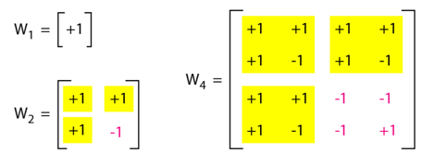
Example
Find the chips for a network with
a. Two stations b. Four stations
Solution
We can use the rows of W2 and W4 in Figure below
a. For a two-station network, we have
[+1 +1] and [+1 −1].
b. For a four-station network we have
[+1 +1 +1 +1], [+1 −1 +1 −1],
[+1 +1 −1 −1], and [+1 −1 −1 +1]

Slide 31
Example
What is the number of sequences if we have 90 stations in our network?
Solution
The number of sequences needs to be 2^{m}. We need to choose m = 7 and N = 2⁷ or 128. We can then use 90 of the sequences as the chips.

